Slide 1

Anomaly Detection to Identify Fraudulent Credit Card Transactions
Group 4:
Razvan Radu
Samanthi Jayarathna
Amar Rai
Salma Abdirahman
Farjana Rowther

Slide 2

Introduction
Credit card fraud detection is a challenging task that requires detecting fraudulent transactions out of millions of daily transactions.
Due to the enormous amount of data, it is now nearly impossible for human specialists to identify meaningful patterns from transaction data.
Therefore, the use of machine learning techniques has become widespread in the field of fraud detection, where information extraction from large datasets is required.
Notes:
Introduction
Brief overview of the project and its goals
Description of the data used and its source

Slide 3
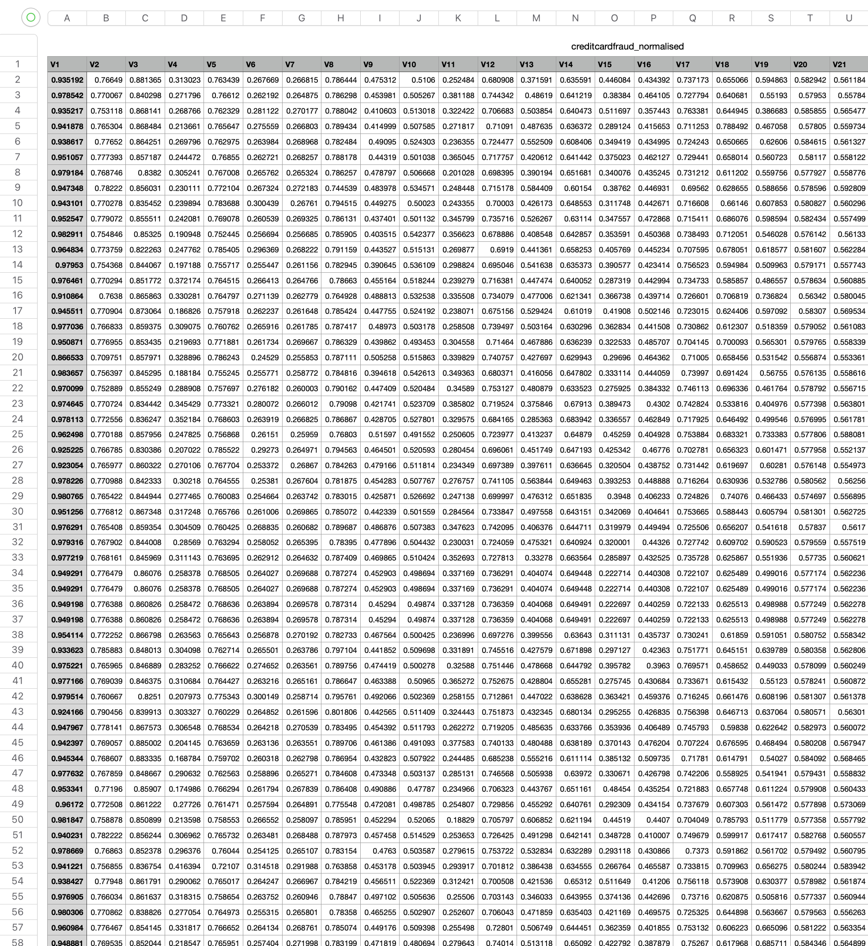
Our dataset
Description
The dataset contains transactions made by credit cards in September 2013 by European cardholders.
This dataset presents transactions that occurred in two days,
Contain a total of 284,807 transactions out of which 492 were fraudulent
Where is it from?
Anonymized normalized real-world dataset was obtained from Credit Card Fraud dataset.
Source: https://github.com/GuansongPang/ADRepository-Anomaly-detection-datasets)
Notes:
Introduction
Brief overview of the project and its goals
Description of the data used and its source
Script: Credit card fraud detection is a challenging task that requires detecting fraudulent transactions out of millions of daily transactions. Due to the enormous amount of data, it is now nearly impossible for human specialists to identify meaningful patterns from transaction data. Therefore, the use of machine learning techniques has become widespread in the field of fraud detection, where information extraction from large datasets is required.

Slide 4
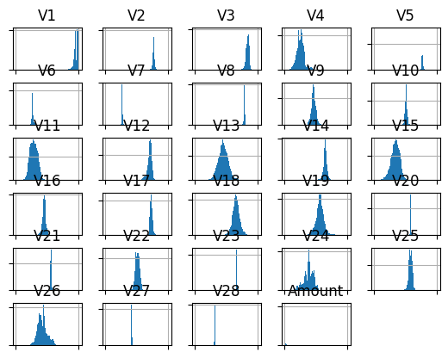


01
Data Preprocessing
Data Cleaning
Duplicate/NaN values were taken out
Normalization/
Standardization
Normalization of the dataset confirmed.
Notes:
Data Preprocessing
Since we obtained preprocessed data directly from the repository, we looked for duplicate/NaN values before confirming that data is indeed is normalized using the normalization plots.
Explanation of the data cleaning process, including how missing values and duplicates were handled
Description of the normalization and standardization methods used

Slide 5
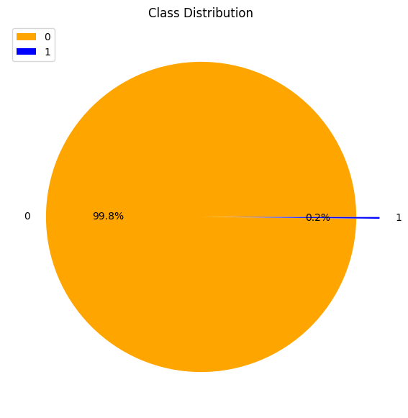
02
Exploratory Data Analysis
Many real life classification problems have inherent imbalanced class distribution -
Fraud Detection.
Claim Prediction
Default Prediction.
Churn Prediction.
Spam Detection.
Anomaly Detection.
Outlier Detection.
Intrusion Detection
Conversion Prediction.
Severely Imbalanced Dataset
Fraud (Class-1) to Non-fraud (Class-0) was 1:577
Notes:
Exploratory Data Analysis
Visualizations and statistics used to understand the distribution and relationships between the variables in the data set
Identification of potential outliers or unusual patterns in the data

Slide 6



Methodology
SciKit Learn ML Library
Tensorflow
Keras
Imblearn
Model Development
03
The dataset was split into training and testing sets
The dataset was run through
Supervised
Unsupervised
Deep Learning Models
Model Performance was evaluated using accuracy, precision & recall metrics
Notes:
Model Development
Description of the machine learning algorithm used, including its strengths and weaknesses
Explanation of the process for splitting the data into training and testing sets
Evaluation of the model's performance, including accuracy and precision metrics

Slide 7
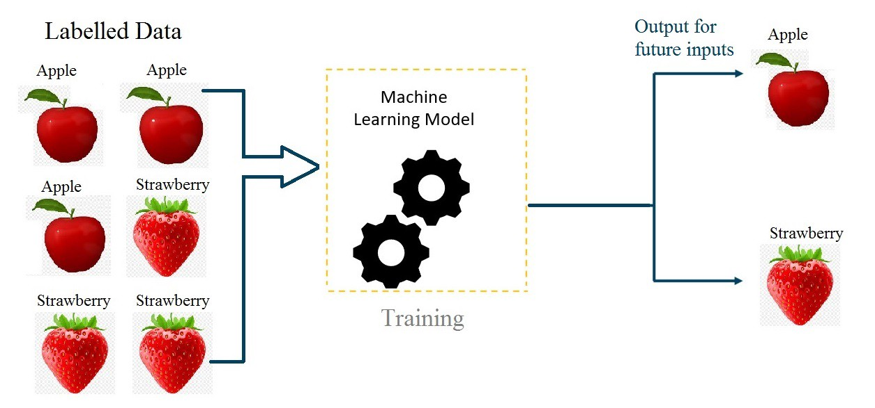
04
Supervised ML Models
These models rely on the data labels to train algorithms that will then classify data or predict the outcomes accurately.

Slide 8
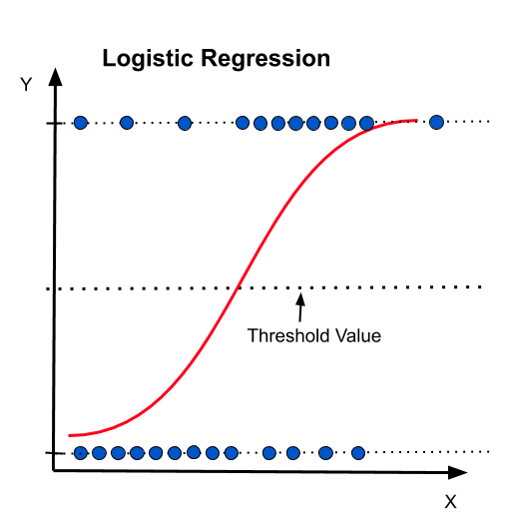
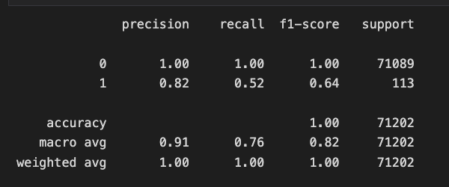
Model Development
Logistic Regression
Class 1 – Fraudulent
05
Class 0 – Non-fraudulent

Slide 9
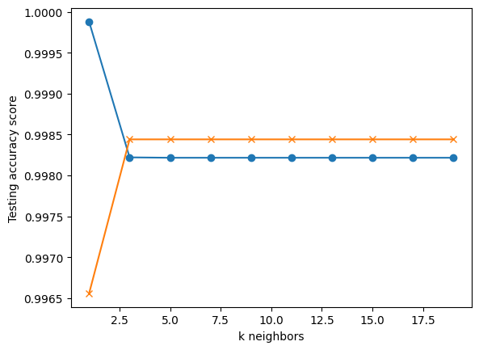
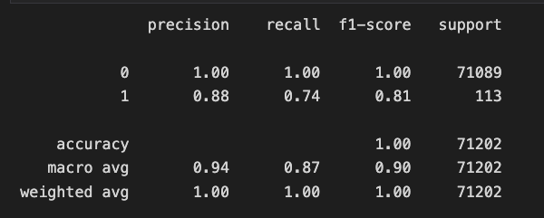
06
K Nearest Neighbors (KNN)
Training Set
Testing Set
Test and Training accuracy stabilized at ~3 neighbors
Slight improvement in the fraudulent class 1 precision and accuracy noted

Slide 10
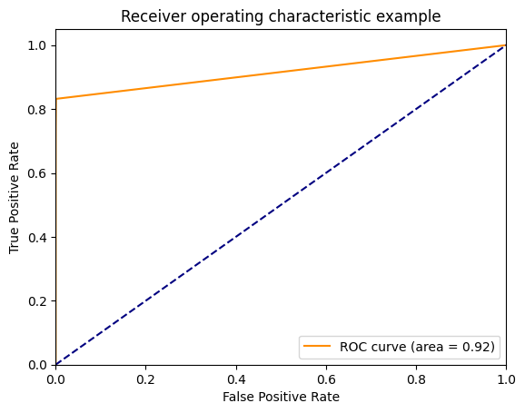
07
ROC Curve
ROC is a probability curve and AUC represents the degree of separability.

Slide 11
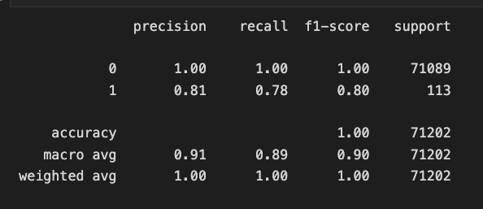
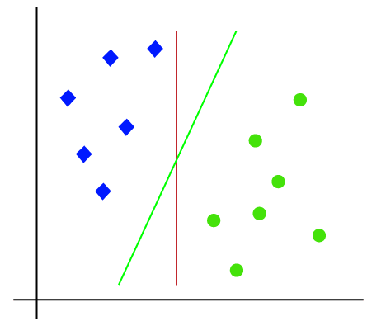
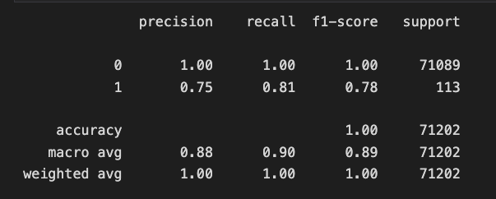
Support Vector Machine
08
Class Weight 1:1
Class 0
Class Weight 1:2
Class 1

Slide 12
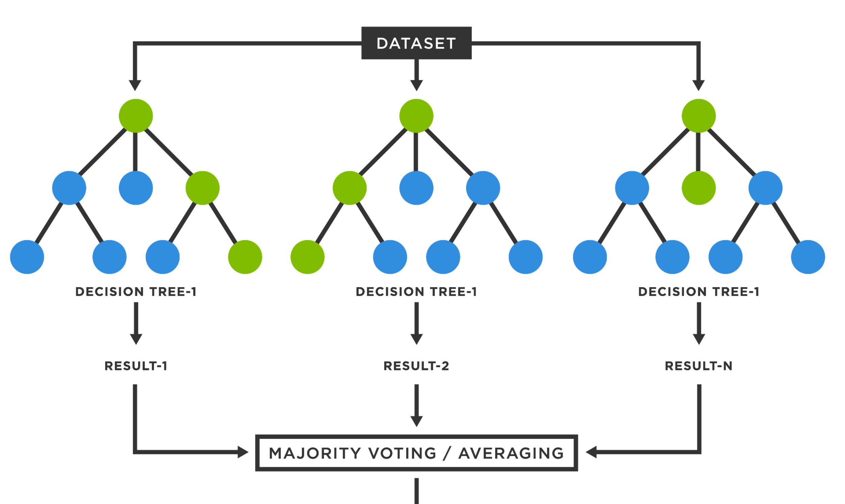
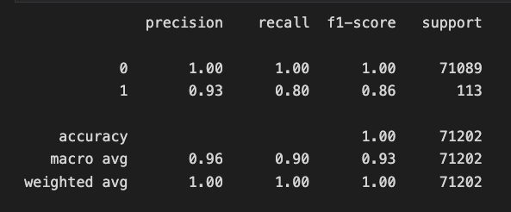
Random Forest Classifier
09
Decision Tree 1
Decision Tree 2
Decision Tree N
Class 1 / Class 0

Slide 13
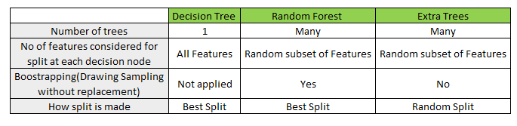
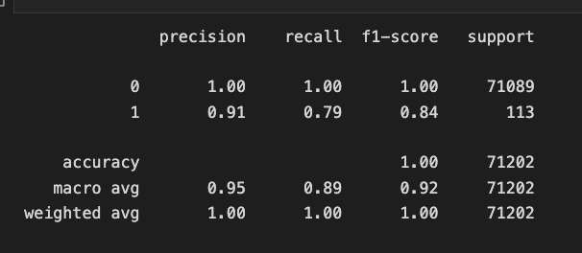
10
Extra Tree Classifier

Slide 14
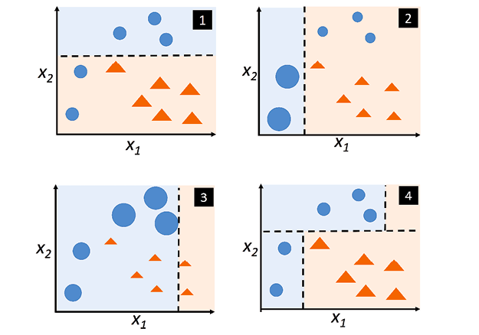
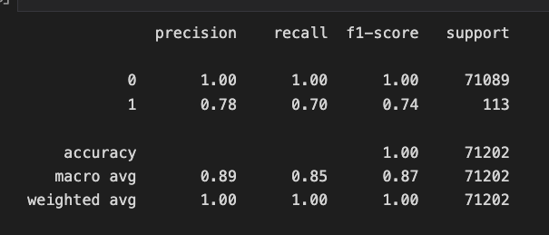
Adaboost Classifier
11

Slide 15
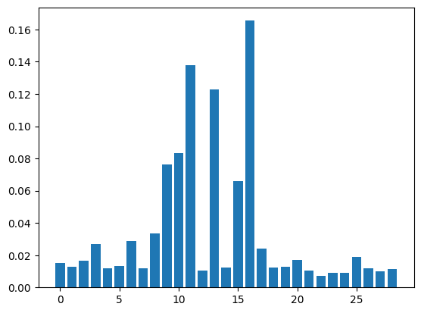
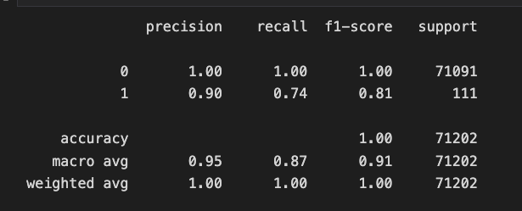
SelectFromModel – Feature Importance
12
Model Development

Slide 16


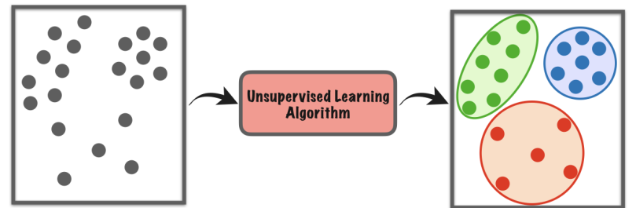
Unsupervised ML Models
13
Unsupervised learning is a type of algorithm that learns patterns from unlabelled data
Clusters the dataset together based on their similarity and differences

Slide 17
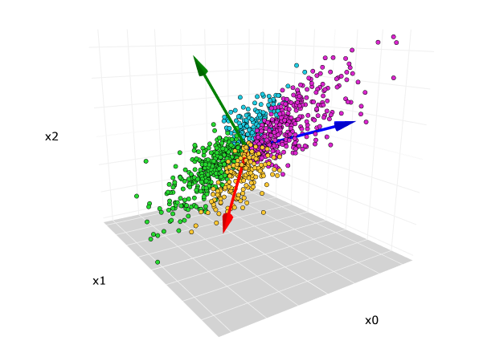
Dimensionality Reduction
Principle Component Analysis (PCA)
14
PCA reduced the number of features from 29 to 13

Slide 18
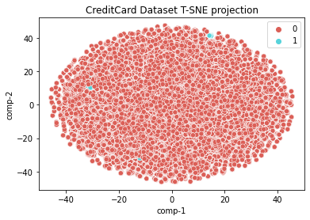

TSNE
15
TSNE unable to distinguish the classes

Slide 19
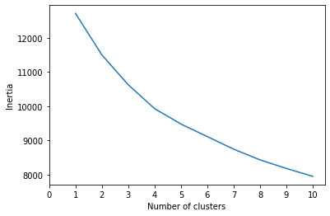

K Means Clustering
16
Elbow Curve -

Slide 20
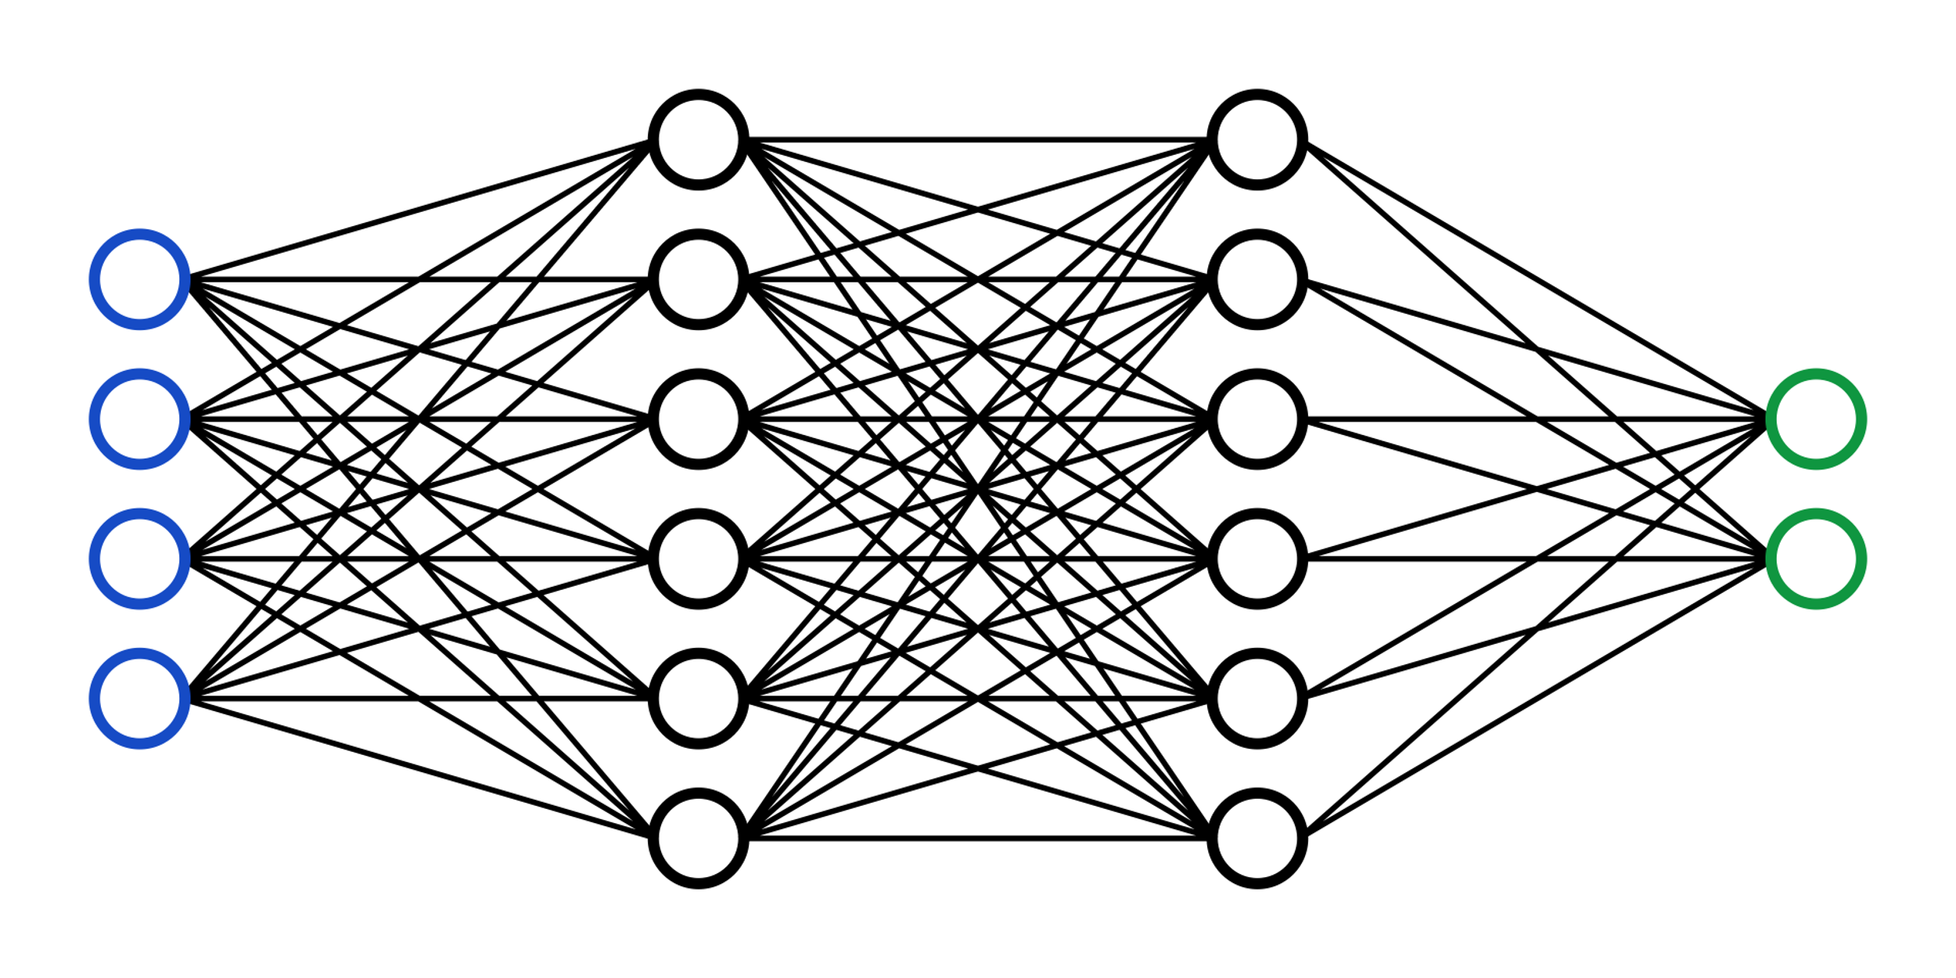
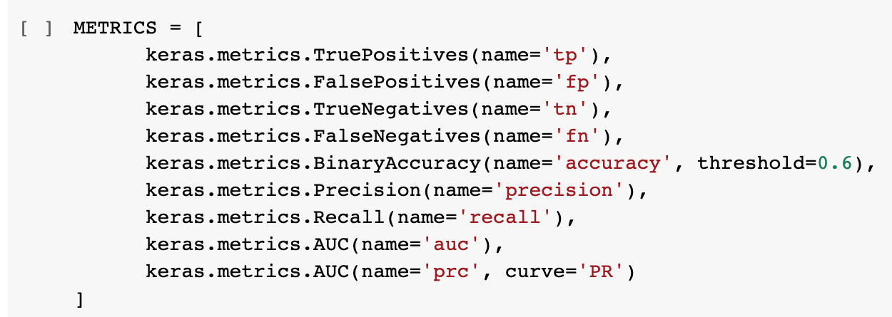
Deep Learning
Class 0
Input Feature
Class 1
17
Notes:
Neural networks (Artificial neural networks (ANNs), are a subset of machine learning algorithms which mimic the working of a human brain with regards how the information is processed and understood.
Neural networks rely on training data to learn and improve their accuracy.
However, once these learning algorithms are fine-tuned for accuracy,
they are powerful tools in machine learning to classify and cluster data at a very high velocity.
In this case to determine whether a transaction was fraudulent or not.
Since the dataset we are dealing with is severely imbalanced, it is very important to note that determining loss or accuracy alone will not give an indication of how well the neural networks are working in predicting the minority class.
Therefore it was paramount to investigate the inner working with regards a lot of metrics including Precision and Recall. These metrics were fed into the network to be computed during the training process.

Slide 21
18
Artificial Neural Network (ANN)
Neural Network | TP | FP | TN | FN | Binary Accuracy | Precision | Recall | AUC | PRC
Threshold - 0.5 (Bi-Accuracy) | 54 | 4 | 28207 | 21 | 0.9991 | 0.9310 | 0.7200 | 0.8799 | 0.7661
Additional Layers | 54 | 4 | 28207 | 21 | 0.9991 | 0.9310 | 0.7200 | 0.8931 | 0.7788
Threshold - 0.6 (Bi-accuracy) | 58 | 4 | 28207 | 17 | 0.9993 | 0.9355 | 0.7733 | 0.8927 | 0.7785
Activation - Tanh | 51 | 3 | 27206 | 15 | 0.9993 | 0.9444 | 0.7727 | 0.9162 | 0.8255
Notes:
Various modifications to the neural network were included whilst training our training dataset. These included increasing the no. of hidden layers, neurons within the layers, changing the activation function and setting the binary accuracy threshold to 0.6.
Here we found that a binary threshold of 0.6 seem to perform the best among various all the hyperparameter changes that we evaluated.

Slide 22
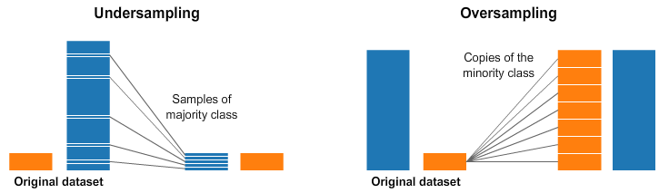
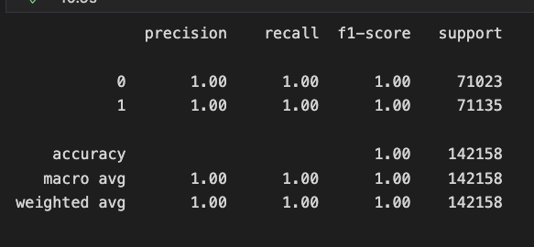
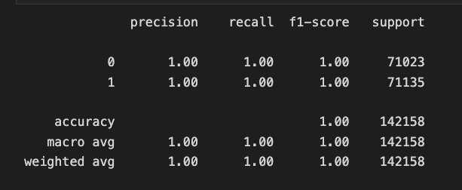
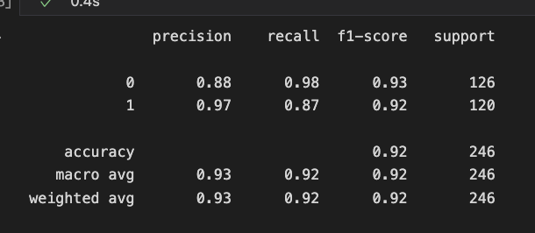
Balanced Dataset
SMOTETomek
RandomOverSampler
Adaptive Synthetic (ADASYN)
Synthetic Minority Oversampling
Technique (SMOTE)
RandomUnderSampler
NearMiss (NM1, NM2 & NM3)
Tomek’s Link
Random Forest Classifier
Random Forest Classifier
Random Forest Classifier
Notes:
One of the common practise in ML world whilst dealing with imbalanced dataset is is to balance the dataset. One of the two main approached are adapted include either to replicate the minority class so it matches the majority OR draw representative samples from majority class to match the minority group.
A third approach could to include a combination of these approaches together to balance the dataset.
We obtained perfect Precision/Recall scores using oversampling and SMOTETomek.

Slide 23
Final Comparison
20
 | Model | Accuracy | Precision | Recall
In Class 0 (Non-fraudulent) | All Models | 1.00 | 1.00 | 1.00
In Class 1 (Fraudulent) | Logistic Regression | 0.82 | 0.52 | 0.64
 | K Nearest Neighbors | 0.88 | 0.74 | 0.81
 | SVM (Equal Class Weight) | 0.81 | 0.78 | 0.80
 | SVM (1:2 Weight for Class 1) | 0.75 | 0.81 | 0.78
 | Random Forest Classifier | 0.93 | 0.80 | 0.86
 | Extra Tree Classifier | 0.91 | 0.74 | 0.81
 | Adaboost | 0.78 | 0.70 | 0.74
 | SelectFromModel | 0.90 | 0.74 | 0.81
Balanced Dataset | RandomUnderSampler (RFC) | 0.97 | 0.87 | 0.92
 | RandomOverSampler (RFC) | 1.00 | 1.00 | 1.00
 | SMOTETomek (RFC) | 1.00 | 1.00 | 1.00
ANN (Testing Scores) | Threshold - 0.5 (Bi-accuracy) | 0.99 | 0.93 | 0.72
 | Threshold - 0.6 | 0.99 | 0.93 | 0.77
 | Activation - Tanh | 0.99 | 0.94 | 0.77

Slide 24




Reflection & Conclusions
Best_Model
Successful at developing modeling with ‘best possible’ Precision and
Recall scores in both imbalanced and balanced dataset
21
Imbalanced Dataset
Larger list of metrics had to be computed to assess the performance of the models
Computationally demanding
Both large dataset and number of metric calculations meant longer modeling time.
Cloud Technologies
Make use of Cloud Technologies (AWS, Azure, Snowflake etc.,) to cope with the increased computational demands

